Slide 1
Crash Severity prediction

Slide 2
Problem Statement and Its Importance
What is the problem? The problem addressed is the prediction of crash severity in urban traffic networks. Given historical data from traffic incidents, the objective is to develop a model that can classify the severity of a crash — such as whether it results in injury/tow or is minor with no injury.
Why is it important?
Urban traffic networks face frequent congestion and high accident rates.
Timely prediction of crash severity helps in:
Deploying emergency services more efficiently
Improving road infrastructure planning
Implementing better traffic regulations
Raising public awareness and enhancing safety measures
It supports data-driven decision-making for city planners, law enforcement, and emergency responders.
How hard is it? This is a challenging classification problem due to:
Class imbalance in real-world data (more minor crashes than severe ones).
Noisy and incomplete data (e.g., missing weather or location data).
Complex interactions between various features such as time, lighting, and road conditions.

Slide 3
Motivation
Public Safety: Enables faster and more targeted emergency response.
Urban Planning: Informs decisions on infrastructure improvements and risk-prone zones.
Traffic Regulation: Supports enforcement policies during high-risk hours/days.
Resource Optimization: Prioritizes deployment of law enforcement and medical units.
Data-Driven Policy Making: Helps authorities implement focused, evidence-based safety campaigns.

Slide 4
Technical challenges
Imbalanced Dataset: Real-world data has far more minor crashes than severe ones.
Noisy/Missing Data: Incomplete weather, road, or location fields complicate training.
Feature Interaction Complexity: Time, lighting, and environmental features interact non-linearly.
Categorical Encoding Bias: Label encoding may introduce unintended ordering in features.
Model Generalization: Ensuring models perform well on real-world unseen data remains difficult.

Slide 5
Solutions Implemented / Proposed
What solutions are implemented or proposed? Multiple machine learning models have been implemented and evaluated:
Logistic Regression
Random Forest
Gradient Boosting
AdaBoost
MLP (Neural Network)
Additionally:
Hyperparameter tuning using GridSearchCV.
Feature selection using Random Forest importance.
Model evaluation using metrics like ROC-AUC, confusion matrix, and classification report.
Are there any assumptions? Yes, the following assumptions are made:
Crash severity is influenced by environmental, temporal, and road-based features.
The sampled dataset (balanced with 20,000 samples per class) is representative of real-world patterns.
Label encoding sufficiently captures categorical variables without introducing significant bias.

Slide 6
Dataset and Feature Description
Dataset Used:
Name: Chicago Traffic Crashes Dataset
Source: City of Chicago Open Data
Shape of the dataset: (794,956 rows × 48 columns)
Key Features Include:
Temporal: HOUR, DAY_OF_WEEK, MONTH
Road and Environmental: WEATHER_CONDITION, ROAD_SURFACE_CONDITION, LIGHTING_CONDITION
Crash Information: NUM_UNITS, DAMAGE, TRAFFIC_CONTROL_DEVICE
Target Variable: CRASH_TYPE
Preprocessing Steps Taken:
Dropped irrelevant columns (e.g., unique IDs, latitude/longitude, and text-based notes).
Removed rows with missing target values.
Encoded categorical variables using Label Encoding.
Balanced the dataset to include 20,000 examples from each crash type.
Applied StandardScaler to normalize numeric features before training models.

Slide 7
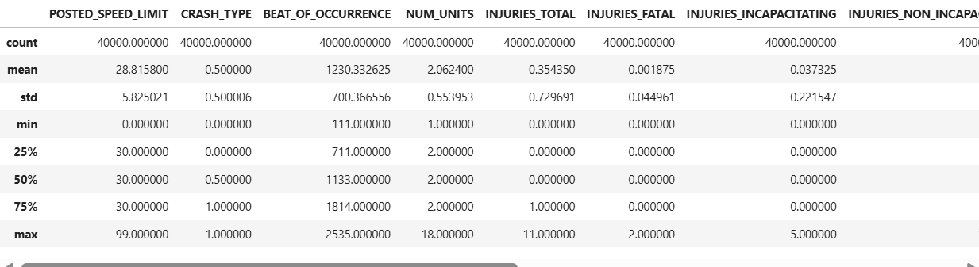
Preliminary results
Most crashes involve 2 vehicles at urban speed limits (~30 mph) and occur throughout the day, peaking around 1 PM.
Injuries are mostly minor or absent, with fatal and severe injuries being rare (average total injuries per crash ≈ 0.35).
The dataset is balanced between severe (injury/tow) and non-severe (drive away) crash types, suitable for classification modeling.

Slide 8
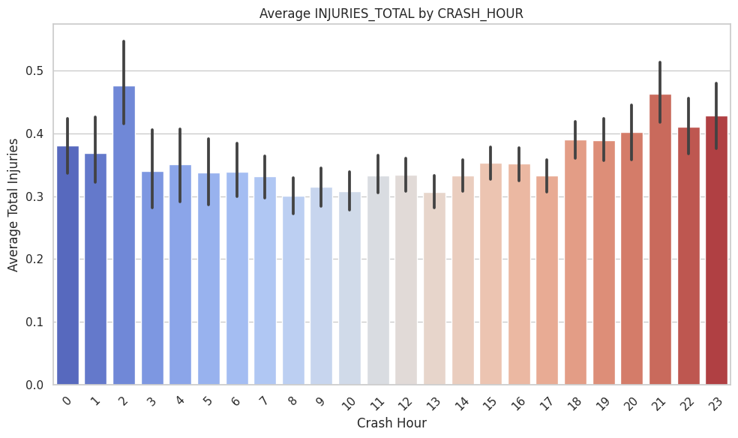
Visual analysis
High-Risk Hours:
2 AM shows the highest average injuries per crash.
Evening hours like 9 PM to 11 PM (21–23) also show elevated injury levels.
Low-Risk Hours:
The lowest average injuries occur between 8 AM and 3 PM.
This period may reflect better traffic regulation and visibility.

Slide 9
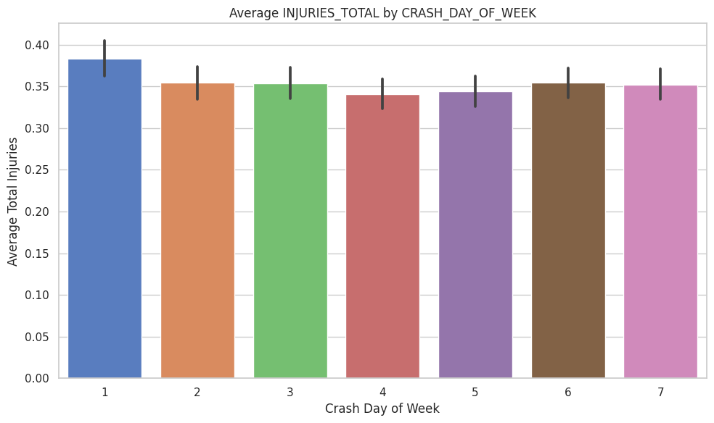
Highest Average Injuries:
Monday (Day 1) records the highest average injuries, slightly above 0.38.
This might reflect higher traffic volume and stress levels at the start of the workweek.
Lowest Average Injuries:
Thursday (Day 4) shows the lowest average injuries per crash.
Midweek may have steadier traffic flow and fewer distractions.
Weekends (Days 6–7) maintain moderate injury averages, likely due to recreational travel and potential for late-night driving incidents.

Slide 10
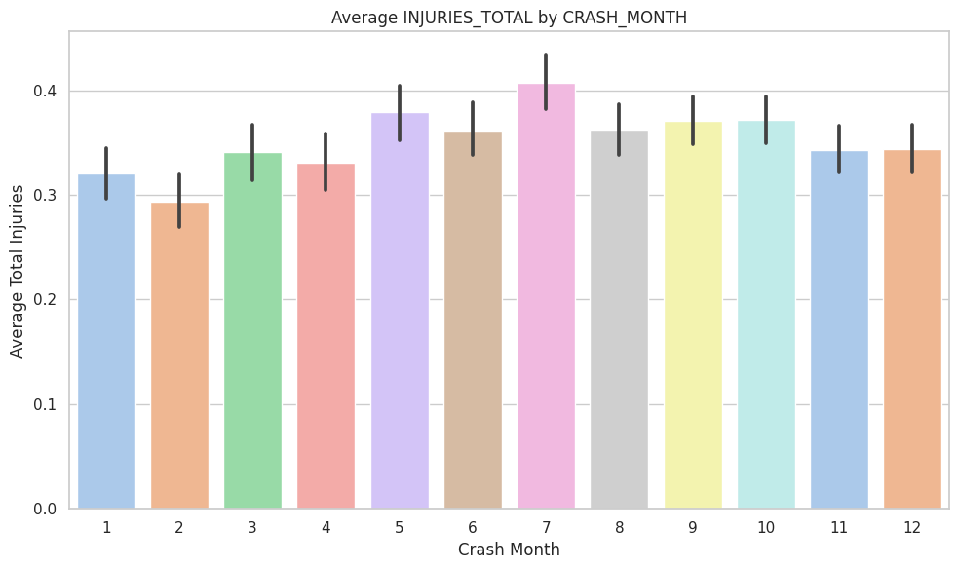
Highest Injury Averages:
July (Month 7) has the highest average injuries, peaking above 0.4.
May and June (Months 5–6) also show relatively high averages.
Lowest Injury Averages:
February (Month 2) has the lowest average injuries per crash.
January (Month 1) follows closely behind.
General Pattern:
Injury severity tends to increase in warmer months (May–August), potentially due to:
Increased road travel and outdoor activity
Riskier driving behavior during holidays or vacations

Slide 11
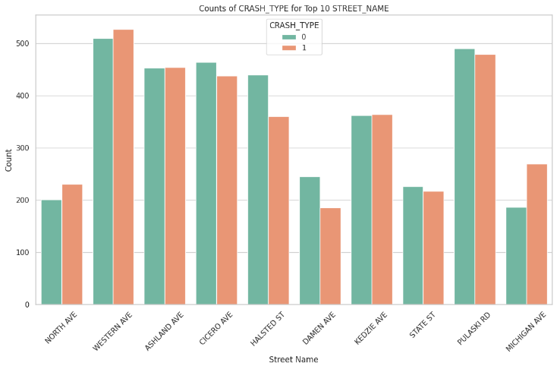
The plot shows the distribution of crash types across the top 10 most common street names in the dataset. Western Ave, Pulaski Rd, and Ashland Ave have the highest total crash counts, with both injury-related (type 1) and non-injury (type 0) crashes occurring frequently. Notably, Michigan Ave and North Ave show a higher proportion of injury-related crashes compared to non-injury ones, indicating they may be relatively riskier. Overall, crash severity varies by street, highlighting the need for location-specific traffic safety measures.

Slide 12
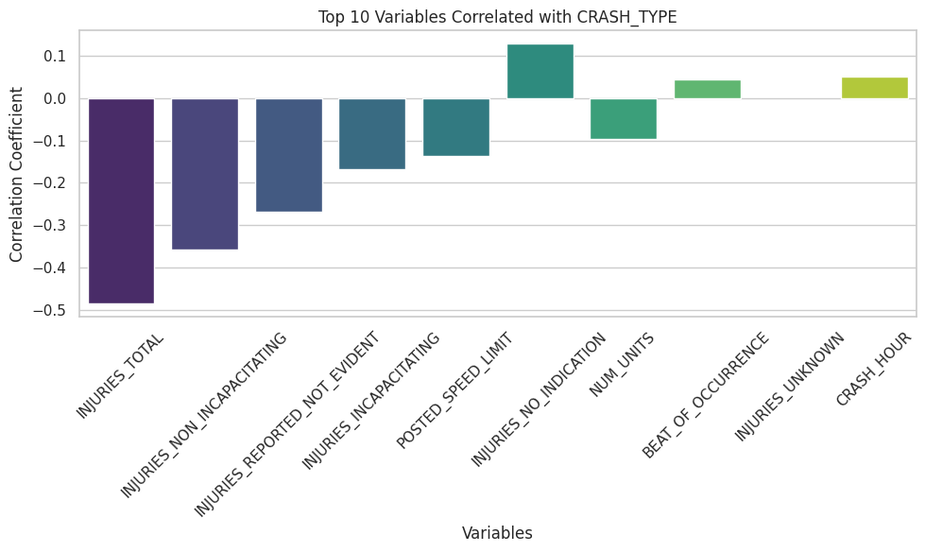
Strong Negative Correlations:
INJURIES_TOTAL (-0.48) has the strongest negative correlation with CRASH_TYPE, indicating that higher total injuries are strongly associated with more severe crashes.
Other negatively correlated variables include:
INJURIES_NON_INCAPACITATING
INJURIES_REPORTED_NOT_EVIDENT
INJURIES_INCAPACITATING
These imply that as injury severity increases, the crash is more likely classified as "INJURY AND / OR TOW".
Positive Correlations:
INJURIES_NO_INDICATION and CRASH_HOUR have slight positive correlations, suggesting they are slightly more common in less severe (drive-away) crashes.

Slide 13
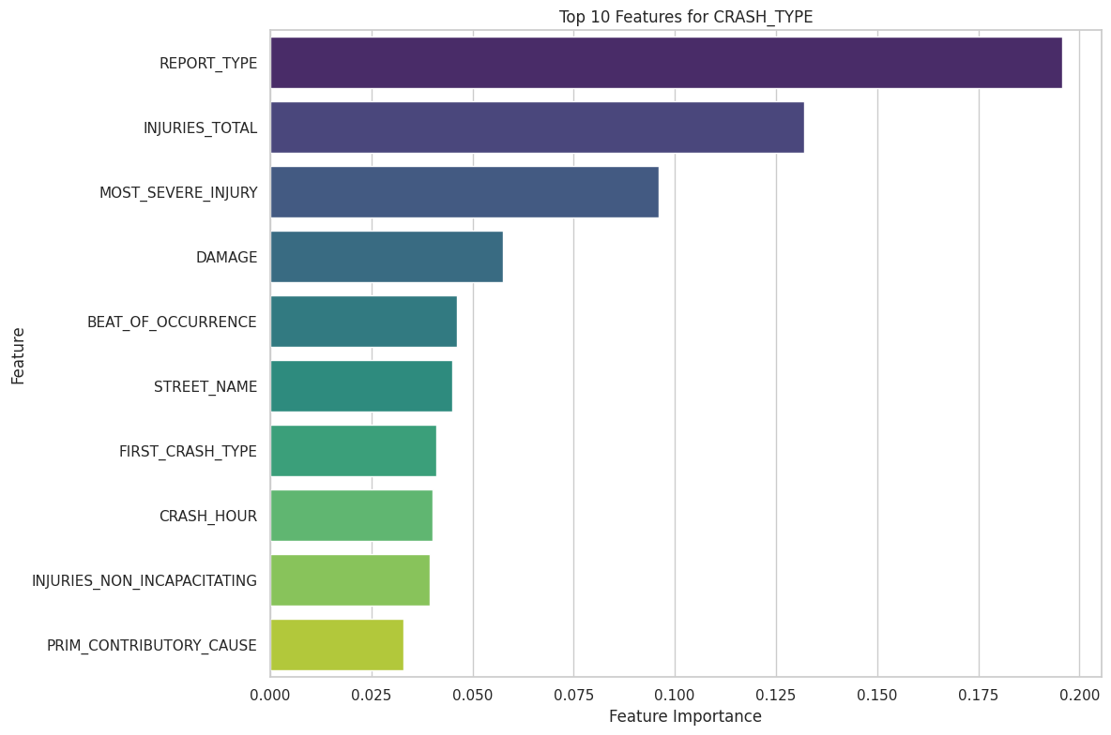
Most Important Features:
REPORT_TYPE is the strongest predictor, suggesting that the type of official report (e.g., officer report vs. driver report) is highly indicative of crash severity.
INJURIES_TOTAL and MOST_SEVERE_INJURY are also top contributors, confirming the direct link between injury data and severity classification.
Contextual and Location Features:
DAMAGE, BEAT_OF_OCCURRENCE, and STREET_NAME hold moderate importance, highlighting that geographical and damage-related data influence severity.
Time-Based Influence:
CRASH_HOUR plays a smaller, yet meaningful role, reflecting how certain hours (e.g., night-time) may increase the likelihood of severe crashes.

Slide 14
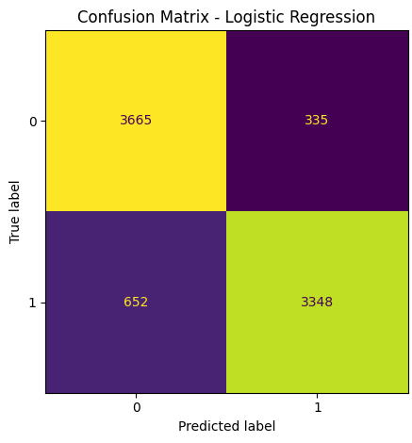
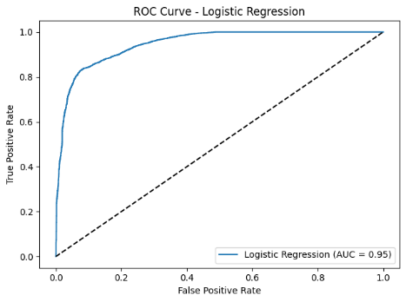
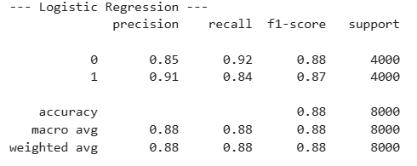
Model performance
Default model: Logistic regression
The logistic regression with default settings did very well with an overall accuracy of 88%. The confusion matrix reveals that it correctly classified 3665 non-injury (0) and 3348 injury (1) accidents, with balanced misclassification on both sides. Precision and recall were balanced with both approximately in the range of 0.85–0.91, and the AUC of 0.95 from the ROC curve is indicative of very good discrimination capacity between the two types of crash severity.

Slide 15
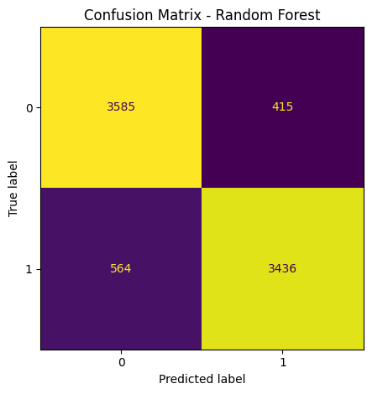
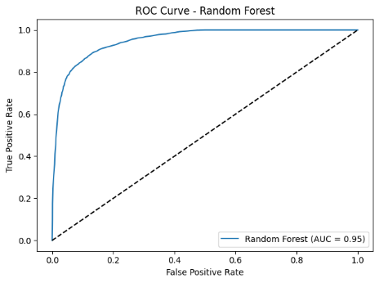
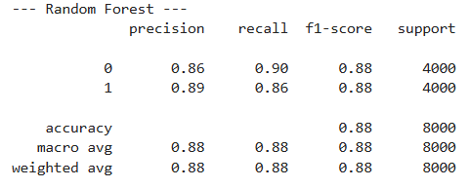
Random Forest
The Random Forest model produced an accuracy of 88%, tied with logistic regression in overall accuracy. It demonstrated slightly better recall and precision balance between both types of crashes with reduced false negatives in injury-related crashes (3436 correct predictions). The AUC value of 0.95 attests to outstanding classification performance. Although both models were alike in performance, Random Forest demonstrated greater handling strength in class splitting with minimal recall improvements in predicting injuries.

Slide 16


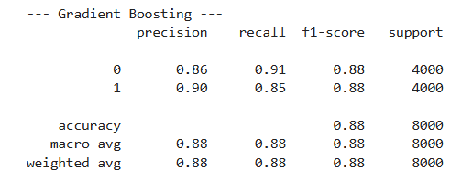
Gradient Boosting
Gradient Boosting attained 88% accuracy with balanced recall and precision across the two classes. It predicted 3626 and 3419 non-injury and injury crashes, respectively. The AUC value of 0.96 is the best among all the models that were tested and signifies better capacity to discriminate between types of crash severity. Overall, Gradient Boosting exhibits robust and consistent classification performance and good discrimination power and is one of the best models in this experiment.

Slide 17

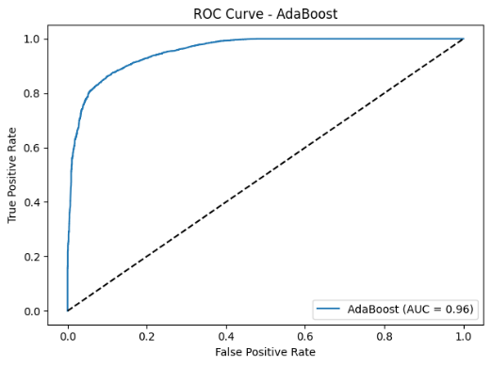
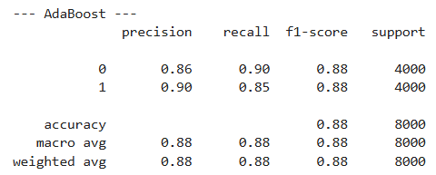
AdaBoost
The AdaBoost model achieved 88% accuracy with similar precision and recall values to Gradient Boosting. It classified 3614 non-injury and 3418 injury crashes exactly. The AUC measure of 0.96 is indicative of very good performance in crash severity class discrimination. Overall, AdaBoost is a robust performer and provides balanced and accurate predictions with minimal compromises in performance.

Slide 18

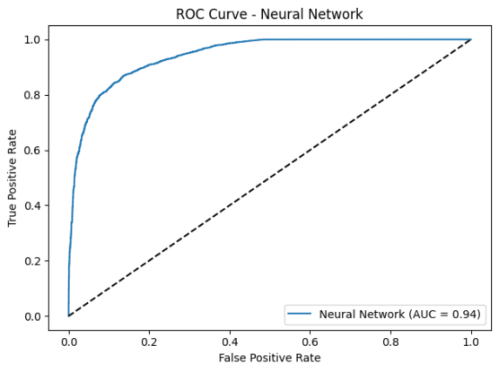
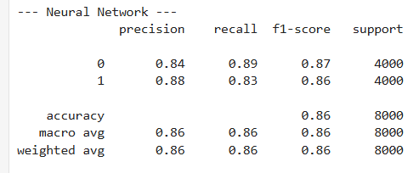
MLP classifier
The accuracy of the Neural Network model was 86%, somewhat less than that of tree-based models. It predicted correctly 3566 non-injury and 3339 injury cases, with a small decrease in the recall of injury crashes. The AUC value of 0.94 remains high in classification ability, albeit behind boosting techniques. Overall, the model worked efficiently but with somewhat increased false negatives in comparison to Gradient Boosting and AdaBoost.

Slide 19
Model tuning
Model | Hyperparameters | Values Tested
Logistic Regression | C (Regularization strength) | 0.01, 0.1, 1, 10
 | solver | 'liblinear'
Random Forest | n_estimators (No. of trees) | 100, 200
 | max_depth (Tree depth) | None, 10, 20
Gradient Boosting | n_estimators (No. of boosting rounds) | 100, 200
 | learning_rate | 0.05, 0.1
 | max_depth (Tree depth) | 3, 5
AdaBoost | n_estimators (No. of weak learners) | 50, 100
 | learning_rate | 0.5, 1.0
Neural Network | hidden_layer_sizes (Neurons per hidden layer) | (50,), (100,), (50, 50)
 | alpha (L2 regularization) | 0.0001, 0.001

Slide 20
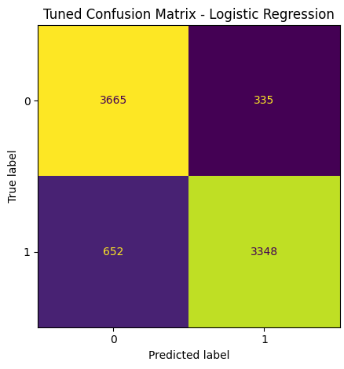
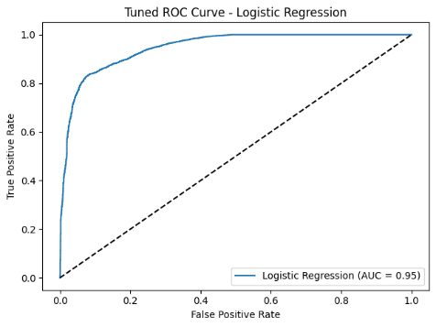
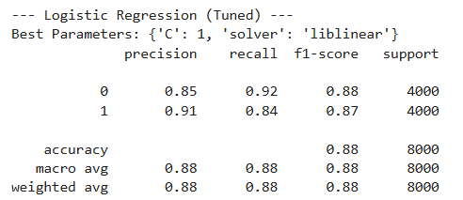
Tuning model: Logistic regression
The tuned Logistic Regression model with C value =1 and solver='liblinear' obtained 88% overall accuracy with excellent class balancing. The model obtained precision values of 0.91 and 0.85 for class 1 and class 0, respectively, proving the accuracy in classification. Recall rates (0.84 and 0.92 respectively) indicate the model is more effective in identifying non-injury crashes. The AUC value of the model is 0.95, showing excellent discriminative power, thereby proving the supremacy of the model in classifying crash severity.

Slide 21
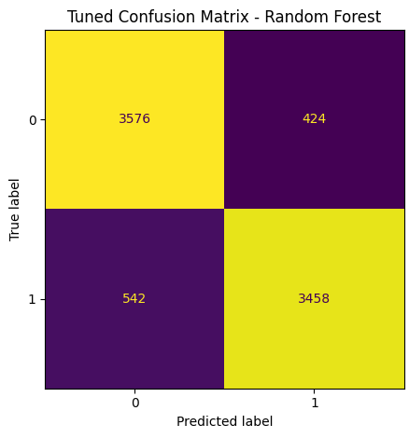
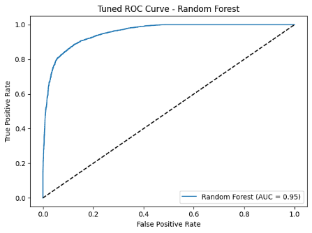
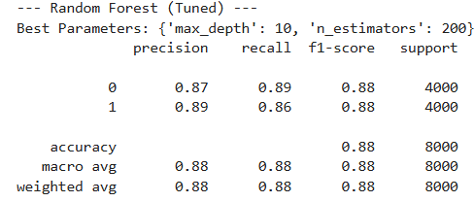
Random Forest
The optimized Random Forest model with 200 estimators and a maximum depth of 10 had an accuracy of 88%. It performed equally good in both classes with precision and recall values of approximately 0.87–0.89. The ROC AUC value was also very high at 0.95, signifying good discrimination power between the classes. The confusion matrix is also balanced with comparatively low rates of false positives and false negatives.

Slide 22
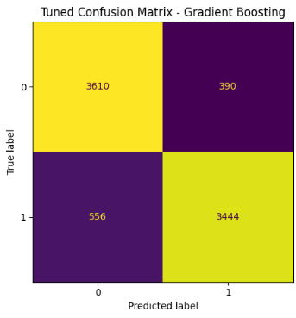
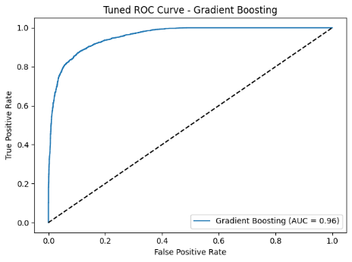
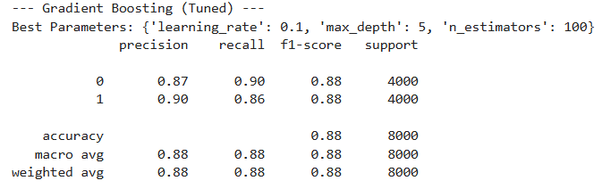
Gradient Boosting
The parameter-optimized Gradient Boosting model, with parameters={'learning_rate': 0.1, 'max_depth': 5, 'n_estimators': 100}, produced robust and well-balanced performance with overall accuracy of 88%. It predicted correctly 3610 of class 0 and 3444 of class 1. A high AUC score of 0.96 implies excellent discrimination power, and precision, recall, and F1-scores are all similar in both the classes and are good indices of robust classification of this dataset.

Slide 23

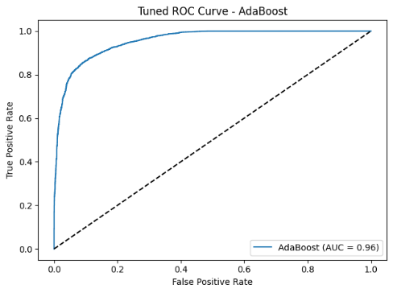
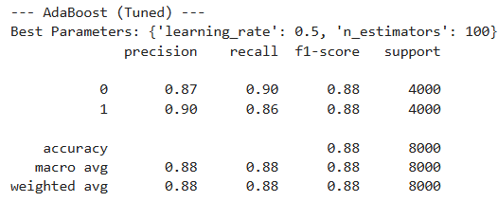
AdaBoost classifier
Using the ideal parameters n_estimators = 100 and learning_rate = 0.5, the optimized AdaBoost model attained accuracy of 88%, with class 1 and class 0 having precisions of 0.90 and 0.87, respectively. The ROC AUC is 0.96, reflecting outstanding classification performance. Misclassification is equally balanced between classes and the model successfully separates between the two types of crashes.

Slide 24


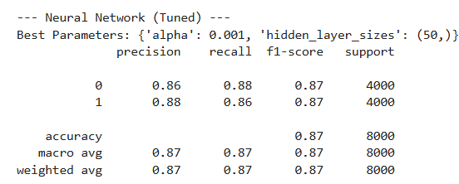
MLP classifier
The MLP (Neural Network) model, after tuning, obtained accuracy as high as 87%, with balanced recall and precision (0.86–0.88) between the two classes. The confusion matrix has only slightly more false positives and false negatives than those of boosting models, though performance is good. The AUC value of 0.95 is indicative of good discriminatory ability. Optimal parameters are hidden_layer_sizes=(50,), alpha=0.001.

Slide 25
Best model
Among all the models, Gradient Boosting was found to be the strongest performer among all models in accuracy, ROC-AUC, precision, recall, and f1-score classification of crash severity in Chicago traffic data. This model obtained accuracy of 88%, ROC AUC Score of 0.96 (maximum across all models). Its capacity to learn sophisticated non-linear patterns and reduce classification errors by iterative boosting rendered it most accurate in this context. It also generalized better on the test set.

Slide 26
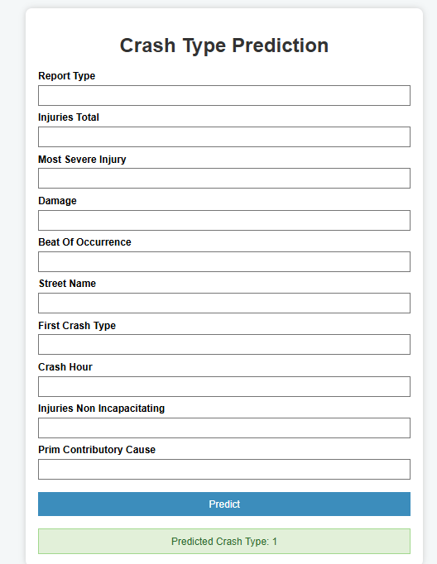
Model deployment analysis
For estimation of real-life usability, the random forest model was implemented in a Flask web application with real-time prediction. For evaluation with a test set, 20 randomly chosen samples (10 injury, 10 non-injury) were used through the UI:
16 correct predictions out of 20 (80% accuracy)
2 cases of non-injury misclassified as injury
2 cases of injuries labeled as non-injury
This confirms that the model used is maintaining strong prediction accuracy outside of the training/testing pipeline, ensuring the model's readiness to be integrated into decision support tools utilized by emergency responders and city planners.

Slide 27
Limitations and improvement
Despite successful modeling and deployment, several limitations and improvement opportunities exist:
Sample Loss Due to Balancing
Balancing the data set using random undersampling might have resulted in loss of valuable data. One should use advanced methods such as ensemble balancing, or cost-sensitive learning in order to preserve richer data diversity.
Model Interpretability
Gradient Boosting, though precise, is not transparent. For public sector implementation, combining SHAP or LIME explanations yields interpretability of how and why specific crashes are given high-risk labels.
Multi-Class Expansion
The simple binary classification is too simplistic in describing crash outcomes. We should classify crashes into finer-grained types such as property damage, minor injury, major injury, or fatality to uncover deeper insights.
Temporal Robustness
Dynamics in traffic evolve with the passage of time. Validating with time-aware or online learning may help ensure accuracy amid changing city conditions.
Geospatial Intelligence
Location-based features (e.g., GPS) were excluded for simplicity but may enhance prediction. Incorporating spatial embeddings or GIS features may provide additional predictive power.
UI Deployment Restrictions
While Flask offered a light-weight deployment framework, scaling to support large-scale, real-time predictions will be better facilitated by switching to a containerized environment with Docker, Kubernetes, or cloud services.

